Slide 1

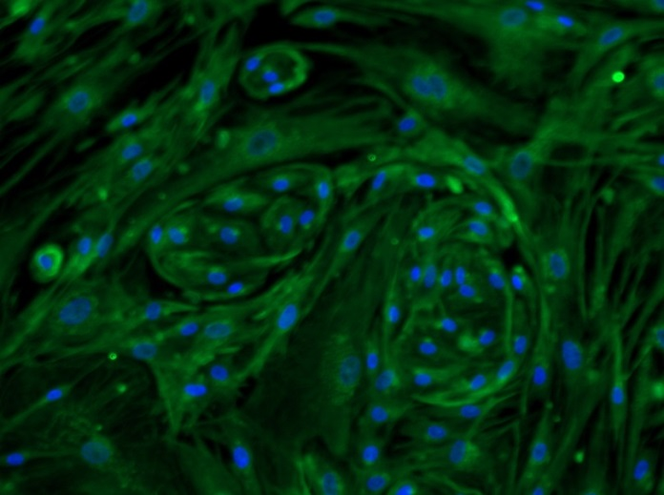
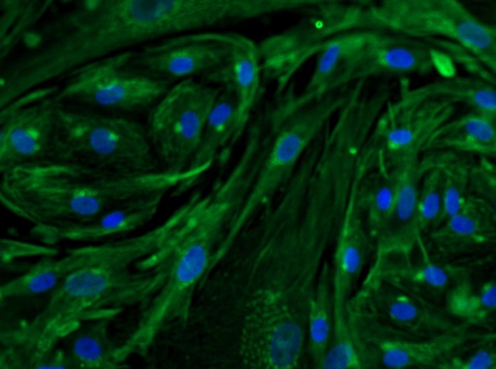
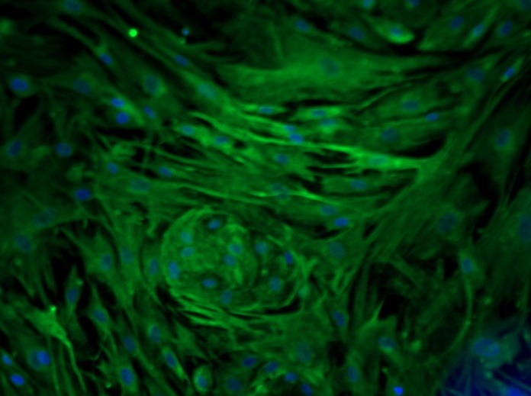
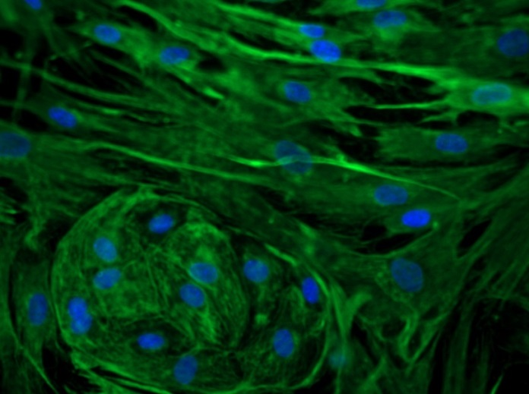
Reliatech GmbH
Mouse anti-human VEGF-A
(Cat# 101-M58;HDLEC/NHDF 1:1)
Immunofluorescence staining of human VEGF-A (#101-M58) in a mixture (1:1) of primary human lymphatic endothelial cells (HDLEC) and primary normal human fibroblasts (NHDF) using a monoclonal antibody directed against human VEGF165.
As secondary antibody goat anti-mouse PE (Santa Cruz; 1:300) and goat anti-rabbit ALEXA Flour 488 (Dianova; 1:600) was used. [IF_LEC1405-04]
.
10µg/ml (200X)
10µg/ml (400X)
10µg/ml (200X)
10µg/ml (400X)
http://www.reliatech.de / orders@reliatech.de

